Slide 1
Spring - Quickstart

Slide 2
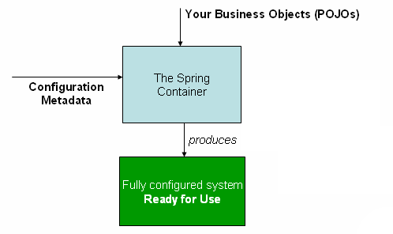
How Spring works

Slide 3
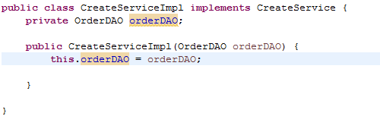
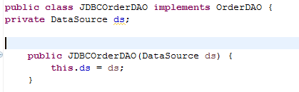
The Business objects

Slide 4
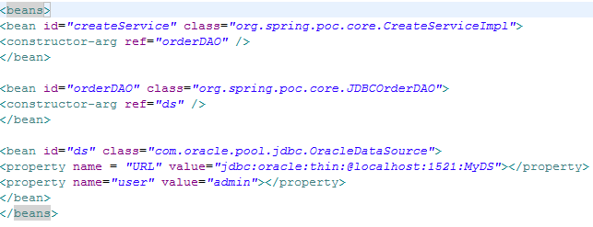
XML Based Configuration metadata

Slide 5
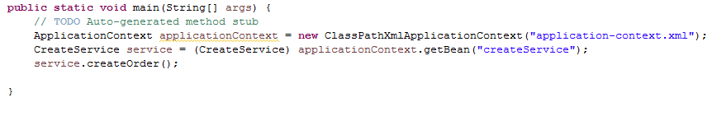
Creating and using the Application

Slide 6

Instantiating a container
ApplicationContext applicationContext = new ClassPathXmlApplicationContext("application-context.xml");
Application Context
createService
CreateServiceImpl
orderDAO
JDBCOrderDAO
ds
DataSource

Slide 7
Bean Overview
Spring manages lifecycle of the application
Beans are created in the right order based on the dependencies
Each bean is bound to a unique ID
Beans are well encapsulated i.e implementation details are hidden

Slide 8
Basic Spring XML Bean Definition
<?xml version=“1.0” encoding=“UTF-8”?>
<beans xmlns=“http://www.springframework.org/schema/beans”
xmlns:xsi=“http://www.w3.org/2001/XMLSchema-instance”
xsi:schemaLocation=“
http://www.springframework.org/schema/beans
http://www.springframework.org/schema/beans/spring-beans.xsd”>
<!-- Add your bean definitions here -->
</beans>

Slide 9
A simple bean definition
A class with no dependencies
<bean id=“createService” class=“org.spring.poc.core.CreateServiceImpl”/>
Results in (via Reflection):
CreateServiceImpl createservice = new CreateServiceImpl ();
ApplicationContext
createService -> instance of CreateServiceImpl

Slide 10
Constructor Dependency Injection
A class with a single dependency expected by its constructor
<bean id=“createService” class=“org.spring.poc.core.CreateServiceImpl”>
<constructor-arg ref=“orderDAO”/>
</bean>
<bean id=“orderDAO” class=“org.spring.poc.core.JDBCOrderDAO”/>
Equivalent to:
JDBCOrderDAO orderDAO= new JDBCOrderDAO ();
CreateServiceImpl createService = new CreateServiceImpl (orderDAO);
createService -> instance of CreateServiceImpl
orderDAO -> instance of JDBCOrderDAO

Slide 11
Constructor argument resolution
The types will be matched when explicit
If types are simple, i.e <value>true</value> Spring cannot determine whether String or Boolean, hence, “type” attribute is used
Use the index attribute to specify explicitly the index of constructor arguments
<bean id="exampleBean" class="examples.ExampleBean">
<constructor-arg type="int" value="7500000"/>
<constructor-arg type="java.lang.String" value="42"/> </bean>
<bean id="exampleBean" class="examples.ExampleBean">
<constructor-arg index=“0" value="7500000"/>
<constructor-arg index=“1" value="42"/> </bean>

Slide 12
Setter Dependency Injection
A class with a single dependency expected by a setter method
<bean id=“createService” class=“org.spring.poc.core.CreateServiceImpl”>
<property name=“orderDAO ” ref=“orderDAO ”/>
</bean>
<bean id=“orderDAO ” class=“org.spring.poc.core.JDBCOrderDAO”/>
Equivalent to:
JDBCOrderDAO orderDAO= new JDBCOrderDAO ();
CreateServiceImpl service = new CreateServiceImpl ();
service.setOrderDAO(orderDAO);

Slide 13
Benefits of Constructor Based Injection
Enforce mandatory dependencies
Promote immutability
Creation and injection in one line of code

Slide 14
Benefits of Setter Based Injection
Allow optional dependencies and defaults
Follow JavaBean™ conventions
Inherited automatically
constructor DI can't deal with cyclic references, resolved with setter injection

Slide 15
Combining Constructor and Setter Injection
<bean id=“service” class=“example.ServiceImpl”>
<constructor-arg ref=“required” />
<property name=“optional” ref=“optional” />
</bean>
<bean id=“required” class=“example.RequiredImpl” />
<bean id=“optional” class=“example.OptionalImpl” />
Equivalent to:
RequiredImpl required = new RequiredImpl();
OptionalImpl optional = new OptionalImpl();
ServiceImpl service = new ServiceImpl(required);
service.setOptional(optional);

Slide 16
General Recommendations
Follow standard Java design guidelines
Use constructors to set required properties
Use setters for optional or those with default values
Be consistent above all

Slide 17
Combining Constructor and Setter Injection
<bean id=“createService” class=“org.spring.poc.core.CreateServiceImpl”>
<constructor-arg ref=“required” />
<property name=“optional” ref=“optional” />
</bean>
<bean id=“required” class=“org.spring.poc.core.RequiredImpl” />
<bean id=“optional” class=“org.spring.poc.core.OptionalImpl” />
Equivalent to:
RequiredImpl required = new RequiredImpl();
OptionalImpl optional = new OptionalImpl();
CreateServiceImp createService = new CreateServiceImp (required);
createService.setOptional(optional);

Slide 18
Injecting Scalar Values
<bean id=“myService” class=“org.spring.poc.core.CreateServiceImpl”>
<property name=“stringProperty” value=“abc” />
</bean>
public class ServiceImpl {
public void setStringProperty(String s) { ... }
// ...
}
Equivalent to:
CreateServiceImpl myService = new CreateServiceImpl();
myService.setStringProperty(“abc”);
myService -> instance of CreateServiceImpl

Slide 19
Automatic Value Type Conversion
<bean id=“myService” class=“org.spring.poc.core.CreateServiceImpl”>
<property name=“integerProperty” value=“29” />
</bean>
public class ServiceImpl {
public void setIntegerProperty(Integer i) { ... }
// ...
}
Equivalent to:
CreateServiceImpl myService = new CreateServiceImpl();
Integer value = new Integer(“29”);
myService.setIntegerProperty(value);
myService -> instance of CreateServiceImpl
Notes:
Can also extend this type conversion system… (you’ll see how to do this later)

Slide 20
Injecting lists
<bean id=“myService” class=“example.ServiceImpl”>
<property name=“listProperty”>
<list>
<ref bean=“abc"/>
<value>123</value>
</list>
</property>
</bean>
Equivalent to:
ServiceImpl myService = new ServiceImpl();
// create list with bean reference, 123
service.setListProperty(list);
myService-> instance of ServiceImpl

Slide 21
Injecting collections
Similar support available for
Properties (through props / prop elements)
Set (through a set element, similar to list)
Map (through map / key elements)

Slide 22
Calling Factory Methods
Some objects cannot be created by a constructor
public class LegacySingleton {
private static LegacySingleton inst = new LegacySingleton();
private LegacySingleton() { ... }
public static LegacySingleton getInstance() {
return inst;
}
}
<bean id=“service” class=“example.LegacySingleton”
factory-method="getInstance" />
Notes:
This slide may include a discussion of singleton by cardinality versus the Singleton Factory pattern. Singleton by cardinality means a single instance in a given scope. In the case of Spring, a single instance in an ApplicationContext. Singleton Factory is the pattern from Design Patterns (GoF) that guarantees singleton by cardinality by tying it to location. A example of this pattern (what most should be familiar with) is shown above. This discussion may highlight the issues with Singleton Factory specifically how it complicates testing.

Slide 23
Calling Factory Beans
Sometimes you want Spring to always delegate to Java code to create another bean
public class ComplexServiceFactory implements FactoryBean {
Object getObject() throws Exception {
// create complex service impl in Java code
}
}
<bean id=“service” class=“example.ComplexServiceFactory”>
<property name=“neededToCreateService” value=“…” />
</bean>

Slide 24
The FactoryBean Contract
Spring auto detects any bean that implements FactoryBean and returns the object created by getObject() to clients
The factory itself is concealed
getBean(beanName)
ApplicationContext
getObject()
object
FactoryBean

Slide 25
A Good Factory Bean Example
Encapsulating the creation of a test DataSource
(1) getBean(“dataSource”)
ApplicationContext
(2) getObject()
(5) dataSource
Runs before
the data source
is usable by
the application
TestDataSourceFactory
(3) createInMemoryDatabase();
(4) populateWithTestData();
Notes:
Maybe mention that there are numerous factory beans out there that are all suffixed with ***FactoryBean

Slide 26
FactoryBeans in Spring
JndiObjectFactoryBean - One option for looking up JNDI objects
FactoryBeans for creating remoting proxies
FactoryBeans for configuring data access technologies like Hibernate, JPA or iBatis
Notes:
‘Broadly speaking, application contexts can be created in a “programmatic” or “declarative” fashion. Today you will mostly see programmatic approaches where you explicitly create application contexts with Java code you write, but Spring provides support for creating application contexts in a declarative fashion as your web app starts up, in a web environment, and this is actually very common. We’ll see this approach later.

Slide 27
Creating a Spring Application Context
Spring application contexts can be bootstrapped in any environment, including
JUnit system test
Web application
Enterprise Java Bean (EJB)
Standalone application
Loadable with bean definitions from files
In the class path
On the local file system
At an environment-relative resource path
Notes:
‘Broadly speaking, application contexts can be created in a “programmatic” or “declarative” fashion. Today you will mostly see programmatic approaches where you explicitly create application contexts with Java code you write, but Spring provides support for creating application contexts in a declarative fashion as your web app starts up, in a web environment, and this is actually very common. We’ll see this approach later.

Slide 28
Example: Using an Application Context Inside a JUnit Test
import static org.junit.Assert.*;
public class CreateServiceTest {
private CreateService service;
@Before public void setUp() {
// Create the application from the configuration
ApplicationContext context =
new ClassPathXmlApplicationContext(“application-config.xml”);
// Look up the application service interface
service = (TransferService) context.getBean(“createService”);
}
@Test public void getOrder() {
Order order =
service.getOrder(1);
assertEquals(order.getName(), “Peter”);
}
…
}
Bootstraps the system to test
Tests the system

Slide 29
Resource Loading Mechanism
ApplicationContext implementations have default resource loading rules
new ClassPathXmlApplicationContext(“org/poc/spring/application-config.xml”);
$CLASSPATH/org/poc/spring/application-config.xml
new FileSystemXmlApplicationContext(“C:\\etc\\application-config.xml”);
C:\etc\application-config.xml
new XmlWebApplicationContext(“WEB-INF/application-config.xml”);
$TOMCAT_ROOT/webapp/WEB-INF/application-config.xml

Slide 30
Resource Loading Mechanism
However, default rules can be overridden with resource loading prefixes
These prefixes can be used anywhere Spring needs to deal with resources
Not just in constructor args /application context
Various prefixes
classpath:
file:
http:
new XmlWebApplicationContext(“classpath:com/poc/application-config.xml”);
$CLASSPATH/com/poc/application-config.xml
Notes:
Of course, the example here is contrived – one likely wouldn't create an XmlWebApplicationContext with a single argument prefixed with 'classpath:'. However, this simple example paves the way to understanding the example shown a couple slides from now where we instantiate an XWAC with a String[] containing a 'classpath:'-prefixed argument.

Slide 31
Creating a Spring Application Context from Multiple Files
A context can be configured from multiple files
Allows partitioning of bean definitions into logical groups
Generally a best practice to separate out “application” beans from “infrastructure” beans
Infrastructure often changes between environments

Slide 32
Mixed Configuration
<beans>
<bean id=“createService” class=“app.impl.CreateServiceImpl”>
<constructor-arg ref=“orderDAO” />
</bean>
<bean id=“orderDAO” class=“app.impl.JdbcOrderDAO”>
<constructor-arg ref=“ds” />
<bean id=“ds” class=“com.oracle.jdbc.pool.OracleDataSource”>
<property name=“URL” value=“jdbc:oracle:thin:@localhost:1521:BANK” />
<property name=“user” value=“admin” />
</bean>
</beans>
Coupled to an Oracle environment

Slide 33
Partitioning Configuration
<beans>
<bean id=“createService” class=“app.impl.CreateServiceImpl”>
<constructor-arg ref=“accountRepository” />
</bean>
<bean id=“orderDAO” class=“app.impl.JdbcOrderDAO”>
<constructor-arg ref=“ds” />
</bean>
</beans>
<beans>
<bean id=“ds” class=“app.testdb.TestDataSourceFactory” />
</beans>
Now substitutable for other environments

Slide 34
Bootstrapping in Each Environment
In the test environment
// Create the application from the configuration
ApplicationContext context =
new ClassPathXmlApplicationContext(new String[] {
“application-config.xml”,
“test-infrastructure-config.xml”
});
In the production Oracle environment
// Create the application from the configuration
ApplicationContext context =
new ClassPathXmlApplicationContext(new String[] {
“application-config.xml”,
“oracle-infrastructure-config.xml”
});

Slide 35
Benefits of Dependency Injection
Your object is handed what it needs to work
Frees your object from the burden of resolving its dependencies
Simplifies your code, improves code reusability
Promotes programming to interfaces
Conceals the implementation details of each dependency
Improves testability
Dependencies can be easily stubbed out for unit testing
Allows for centralized control over object lifecycle

Slide 36
LAB

